Slide 1
New Mexico Order of the Eastern Star
Striving for a Better Tomorrow
for our Organization
Presentation on Marketing Initiative by NM OES as of 5/11/2019

Slide 2
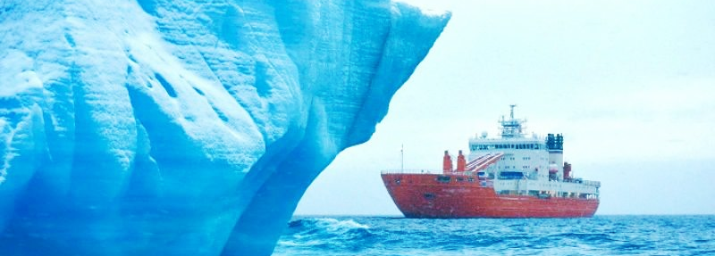
This Time-Our Time
One of the greatest times in our organization
Perhaps…no more of an important and critical time than right now to change the course of our direction

Slide 3
NM Situation- Our Storm

Slide 4
NM Situation- Our Storm

Slide 5
GGC Situation- Our Storm

Slide 6
GGC Situation- Our Storm
Some selected years to get an view over time
PLACE | Number | Year | GC Membership | Sub C. Mem. | Total Membership | # GC | #Sub C
Indianapolis, IN | 6th | 1889 | 33,567 | 2,013 | 35,580 | 16 | 39
Boston, Mass | 8th | 1895 | 98,157 | 3,073 | 101,230 | 25 | 64
Detroit, MI | 10th | 1901 | 206,229 | 6,435 | 212,664 | 35 | 104
Milwaukee, WI | 12th | 1907 | 368,246 | 466 | 368,712 | 47 | 10
Chicago, IL | 14th | 1913 | 604,814 | 2,029 | 606,843 | 48 | 33
Seattle WA | 16th | 1919 | 850,828 | 3,312 | 854,140 | 51 | 37
Toronto ON | 18th | 1925 | 1,556,875 | 4,523 | 1,561,398 | 54 | 41
San Antonio TX | 20th | 1931 | 1,771,356 | 4,422 | 1,775,778 | 55 | 27
Indianapolis IN | 22nd | 1937 | 1,449,190 | 4,756 | 1,453,946 | 55 | 41
Tampa FL | 25th | 1946 | 1,731,094 | 5,930 | 1,737,024 | 55 | 59
Washington DC | 28th | 1955 | 2,354,636 | 11,142 | 2,365,778 | 56 | 72
Miami Beach FL | 30th | 1961 | 2,401,143 | 13,855 | 2,414,998 | 56 | 71
Milwaukee, WI | 33rd | 1970 |  |  | 2,692,996 | 56
Toronto ON | 36th | 1979 | 1,938,672 | 13,472 | 1,952,144 | 56
Anaheim CA | 37th | 1982 | 1,819,364 | 12,104 | 1,831,468 | 56
Atlanta GA | 39th | 1988 | 1,534,199 | 9,590 | 1,543,789 | 56 | 88
Memphis TN | 41st | 1994 | 1,199,344 | 7,957 | 1,207,301 | 56 | 86
Detroit, MI | 43rd | 2000 | 900,028 | 8,352 | 908,380 | 56 | 110
Minneapolis MN | 45th | 2006 | 635,465 | 6,062 | 641,527 | 58 | 98
Fort Worth TX | 47th | 2012 | 454,215 | 5,792 | 460,007 | 58 | 107
Pittsburgh PA | 48th | 2015 | 389,070 | 4,774 | 393,844 | 59 | 76

Slide 7
The Time is Now
This is an exciting time
The challenges before us have never been greater
It is up to us to overcome these and be more
So let’s talk

Slide 8
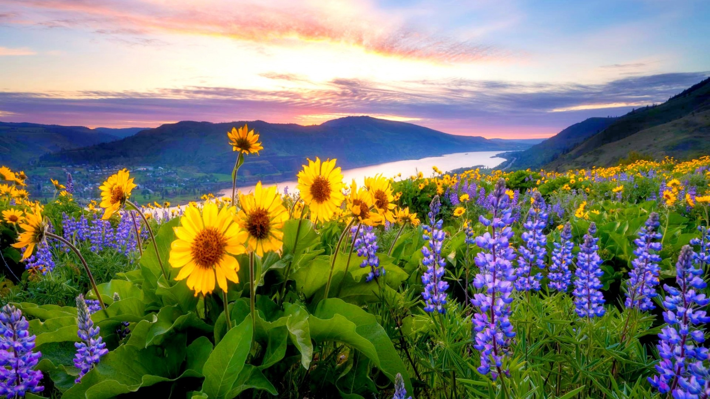
What Can We Be?
What is the best picture
Greatest organization for which to belong-what does that organization represent, accomplish, and offer to its members and the world?
What do we as leaders need to do?
Paint the picture

Slide 9
The Journey -- Courage, Faith, Commitment, Intensity
So what is holding us back? How do we get to that green field we painted?
We have the foundation—A solid foundation ready to build to the next future. Our ritual is timeless, our values we hold dear substantial; yet, advancing into the future has been challenging. To remain relevant in perception has been challenging. The plan is NOT about changing our ritual or our signet/emblem at all, but becoming relevant and a “fit” in today’s world.
But we are still held back by ourselves. Maybe these images speak to us?

Slide 10
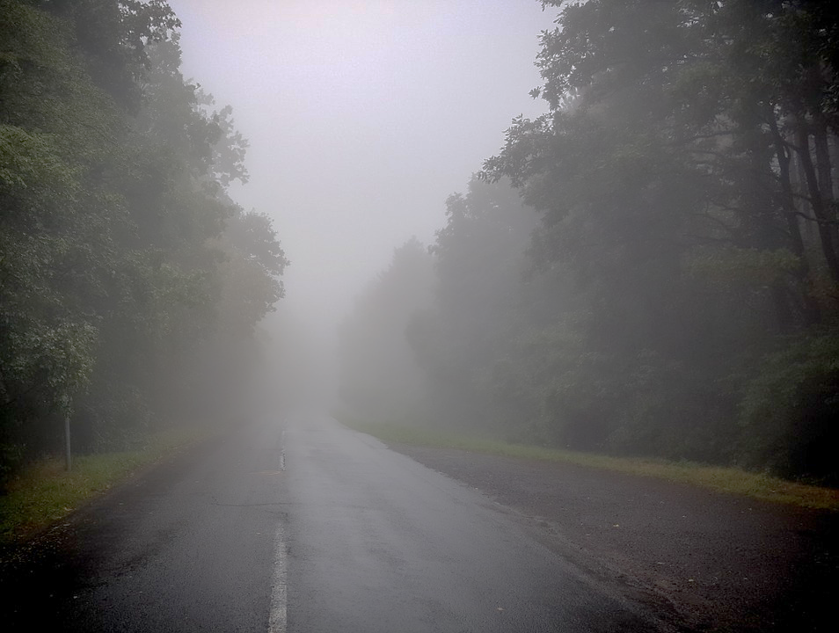
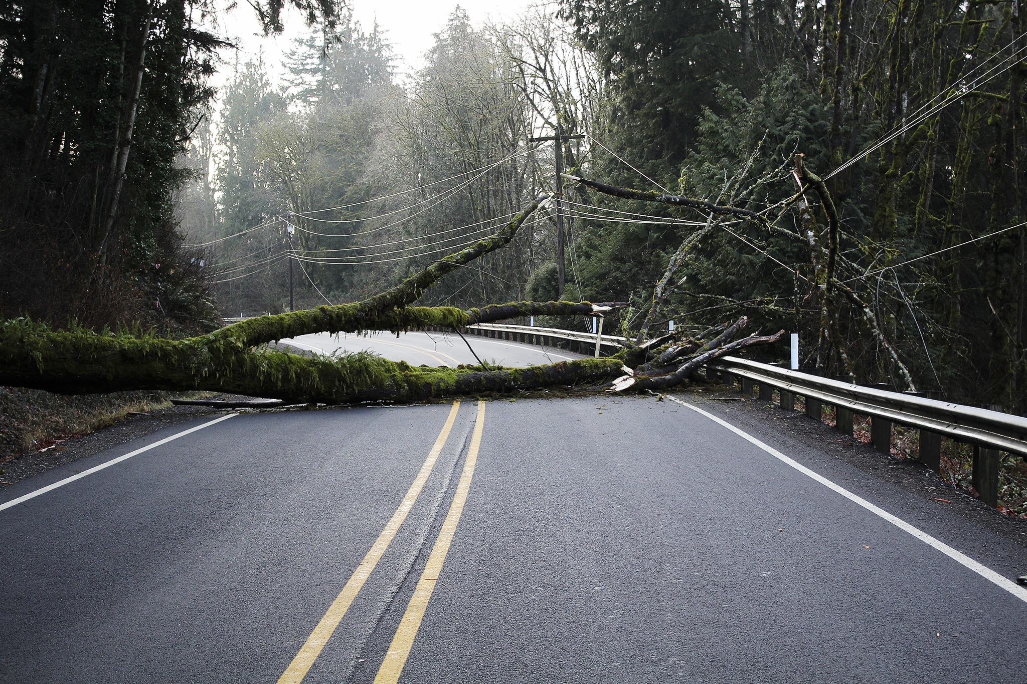
The Road
The truth is:
We can’t just keep going the way we are
We have to be willing to do something new
If we don’t paint the picture, someone else will do it for us

Slide 11
If we don’t, we won’t be
What NM has accomplished since January 2017
Comprehensively Accessed Where We Were
Mapped Where We Want to Be
Began on that Journey

Slide 12
The Journey Has Begun
Level of commitment
1------------5-----------10
Level of Intensity
1---------5------------10
What are you willing to
Commit“?
For the past three years, NM has been working toward a goal to address some very difficult issues
This has been an organic process, developing into a very structured, planned process with organized participation
It takes all of us
NM has reached a step to get everyone really involved
NM believes it truly takes the highest level of commitment and intensity to achieve what needs to happen. What level are you will to commit?

Slide 13
Vision and Mission Created 2017
It is essential to have unified brand message.
Vision
“Together we enhance lives and communities through service and fellowship based on biblical principles.”
Mission
Join! Learn! Impact Your World!

Slide 14
A View of the Marketing Process
Business Vision and Mission Statement
Situation or SWOT Analysis
Objectives
Vision
“Together we enhance lives and communities through service and fellowship based on biblical principles.”
Mission
Join! Learn! Impact Your World!
Marketing Strategy
Target Market Strategy and Goals for each Objective
Marketing Mix
Product
Distribution
Promotion
Price
Implementation Evaluation Control

Slide 15
Created The Power of Three Initiative
Mission
Join! Learn! Impact Your World!
Join
1. Recruit members
2. Share the history of
world-wide organization
and who we are today
3. Enjoy fellowship / Enhanced Member Experience
Learn
1. Tenants (signet)
Leadership
Speaking
Impact the World
National Charities / Service
State Charities / Service
Local Charities / Service
1.
2.
3.

Slide 16
Established Objectives
Development of branded materials / membership recruitment tools
Stronger digital footprint (State level and assistance in helping Chapters obtain this)
Enhanced Member Experience /Continued education / training for membership
State-level promotional strategy (advertising and public relations initiative)

Slide 17
Objective 1
Development of branded materials
/ membership recruitment tools
Including an identifiable fun logo
What New Mexico has been doing –
All decisions have been based on many strategic
Initiative meetings and based on research
Let’s look at marketing logo research

Slide 18
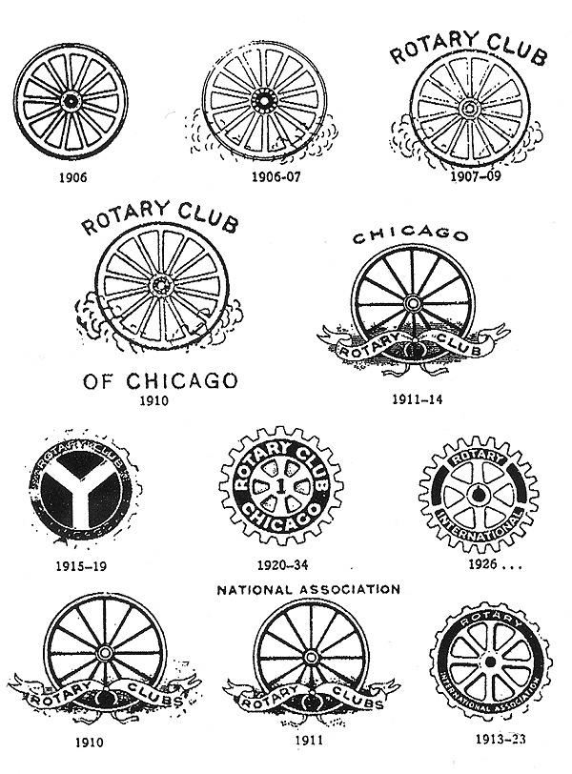
Organizations continually “evolve” their logo to “fit” with the times. Simpler logos is the trend.
https://www.rotary.org/en

Slide 19
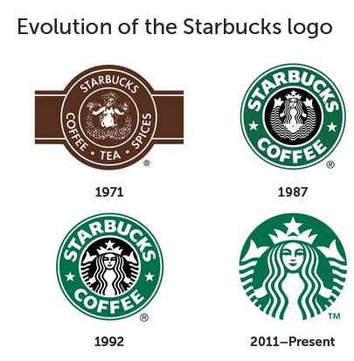
Starbucks is another example of simplifying their logo, but there are thousands who have done this.
Making your logo simple and easy to understand is extremely important for brand clarity and modernization.

Slide 20
Trends in Logo Design
Reasons
Trends to simpler logos are evident in the marketplace, especially with the use of logos that are viewed on smaller viewing screens in the digital era.
To reduce confusion or mis interpretations about complicated logos
Updating logo will benefit organization's public presence
Organization is seeking a renewal of recognition
To reduce negative associations with the brand

Slide 21
Trends in Logo Design
Additional Reasons
Other reasons organizations update their logos or create a different public logo from their corporate logo are:
Trends in logo design are toward minimalism
Simpler logos are easier to understand and associate with a brand
Relatively flat, wordless or simpler logos, are more readable on small screens
Consumers find minimalist logo designs with no text more personal and less corporate

Slide 22
Research
NM has now completed several studies and researched possible variations of a logo to find which images may be best used to appeal to an audience who are not members. We certainly don’t want our marketing image to the world to be confusing or a significant “road block” to even talking to us about our organization.
As a point of clarification: NM is NOT about changing the emblem. That is to remain unchanged. NM is about finding images that can represent our Order, that can be used as a marketing tool/logo to the outside world.

Slide 23
Here is some of that Research
In a survey of random non-members across the United States of over 650 individuals about what they thought this image meant and their opinion of the image, the results were alarming.
What we hold as priceless and dear, to the outside world has quite a different opinion.

Slide 24
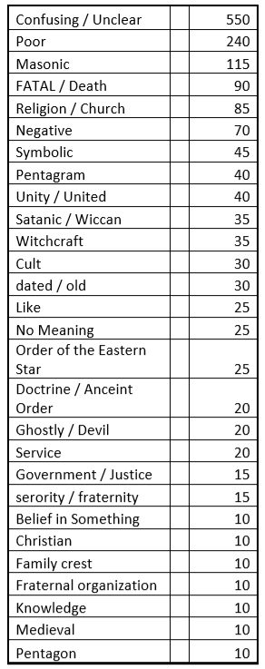
Findings
--550 of 650 respondents (86%) found this image confusing and unclear. For a marketer and consideration of branding elements, this becomes alarming.

Slide 25
Findings
--Remember it is not what we think of ourselves. It is what the outside world thinks of us we have to consider.
--After testing this image, we decided to develop and test some other images, including ones with dogs since that is our international charity (Service Dogs)

Slide 26
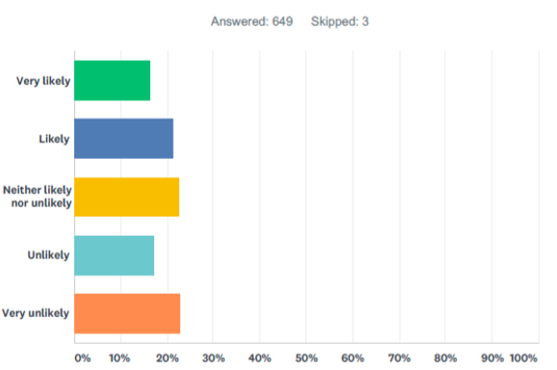
Tested Variations
There was a lot of work done in this stage, this is just a quick re-cap.
--We wanted to know what the average consumer’s perception (opinion) of these images were and what they thought they meant.
We wanted to know how likely an individual would be interested in knowing more about the organization if they saw this image.

Slide 27
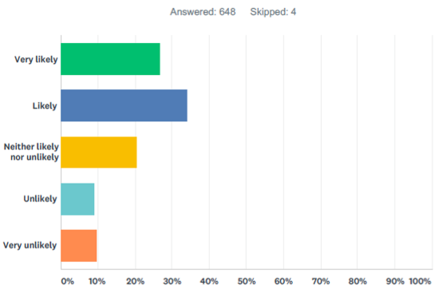
Tested Variations
How likely if you saw this image would you click on the image to learn more or if you saw a person wearing a pin with the image, would you ask more about it?
--We are about “Service Dogs” as we need to brand with an associated charity for greater success, such as Shriners has done for Burn Hospitals, Kiwanis has done for “Serving the Children of the World,” Optimist has done for eye glasses, etc.
The use of a dog with our Star helped with a more friendly, open perception of our organization, but still not fantastic. The star being upside down, with especially the white point down, and the circle, still represented a perception problem.

Slide 28
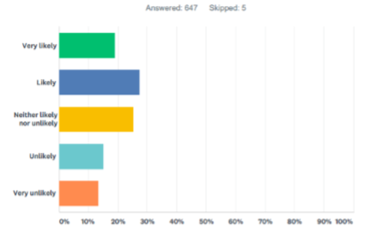
Tested Variations
How likely if you saw this image would you click on the image to learn more or if you saw a person wearing a pin with the image, would you ask more about it?
--There were places in the surveys to provide other feedback and since the dog was so predominate in the previous tested logo, the perception seemed to shift to being that we were a dog focused organization, so we wanted to test some more.
We found that a paw print conveyed an open and friendly image, without distorting an overall perception. Yet, there were considerable negative comment still about the star position, circle, and what the letters OES represented. So we kept working…

Slide 29
Continued to Test New Variations
--Word cloud of comments when dog component added.
Looking at the many other comments to open-ended questions, through interviews and focus groups, additional surveys, a new direction was taken in finding a logo that could be used that would be more open and “appealing” to the outside world. This was a long process… Here is where it arrived…

Slide 30
After Considerable Additional Research
This logo evolved from the different possible logos that were extensively tested. This logo represents a forward moving, more modern simple look, that still holds true to our values represented in the five colors/points of the star. It is a shooting star with gold and has the paw print derived from the Paws and Stripes organization. The circle was removed to reduce confusion with satanic references. The white point is smaller and not straight down, which when presented larger and down can be associated with Wiccan. There are other subtle imagery depictions addressed to finally find an image that was tested as most pleasing and not a barrier to inquiry of others about who we are. This has become a branding tool for NM and now General Grand Chapter, as it has been adopted by GGC.

Slide 31
Back to the objectives– The logo was created and then branded materials and recruitment tools were created.
Objective 1
Development of branded materials
/ membership recruitment tools
Included fun logo
To get other state’s logos and marketing tools, go to www.oestools.org.

Slide 32
What this has involved:
Objective 1-Continued
Chapter Media Kits and Marketing Material Development
Membership Recruitment brochures
Media guide manuals
Brand bible
Chapter banners

Slide 33
Objective 2
Looking at other objectives of marketing plan
Establish a Stronger Digital Footprint
Goals for Objective 2
New website Underway—Launch in summer. For the landing page a custom professional video was created for NM showcasing the positive services and fellowship. Additional research was conducted to determined more effective branding slogans and messaging.
Special Landing Page VIDEO
Chapter websites Once new state website is launched, then chapters will have the template, as connected to state website, to brand uniformly and easily with state branding efforts.
Social Media When website is complete, then social media will be a focus with uniform branding, messaging, and guidance provided to chapters on best practices.
https://vimeo.com/325143301/7025bd34ba

Slide 34
More on Objective 2 –
Establishing a Good Digital Footprint
What New Mexico has been doing –
All decisions have been based on many strategic
Initiative meetings and based on research.
Website development using research to ensure messaging that
The “outside world” can more easily understand and not “close
doors”
Video content
Photo asset development
Message development (See survey results next slide)
Future- Launch of website and training for membership
Marketing & Membership Committee / Board
Training team
Chapter websites

Slide 35
Preliminary Research on Most Appealing Messaging
Finding slogans or appealing messaging can be as challenging as determining a logo. This process is still underway and will develop more over time with additional testing. The process included:
Asking members what OES meant to them
An extensive NM member survey implemented over 3 months at the Grand Chapter and Subordinate Chapter levels
Additional focus group / marketing team meetings in NM
Additional discussion and inclusion of ideas from General Grand Chapter executive board/elective line officers
Pilot testing of proposed slogans and messaging
Inclusion into NM website to be launched in summer 2019. Additional research will be done through A/B tested social media campaigns in future months as well as a larger digital survey potentially across the U.S. depending on funding.

Slide 36
Preliminary Research on Most Appealing Messaging
Messaging Developed and Tested: 18 question “Pilot Slogan” survey
Slogans/Messaging Tested: (These were tested in different sets and randomly displayed to survey respondents)
Not Just an Organization- A Family
Join Our Family and Help Make a Difference
From an Individual to a Family
From Strangers to Family
Eastern Star will give you acquaintances, who become friends, who become family
Dedicated to Charity, Truth, and Loving Kindness
Stronger Together-Fidelity, Constancy, Loyalty, Faith, and Love
Make a Difference, Make It Happen
You will find friends who will stand by you in the journey of life
Supporting veterans and service dog charitable projects
Join, Learn, Impact Your World

Slide 37
Results
It is difficult to explain in one slide the various ways these slogans were evaluated and scored through a weighted average on different dimensions, but here is a quick snapshot of some of the findings.
Weighted score included perception, appeal, and interest assessments on respondents who are not members of the Order.
The higher the score the more appealing the message.
The score is not the number of people tested. It is the result of formula used to score the success of the message.
Slogan/Message Tested | Weighted Score
Make a Difference, Make It Happen | 109
Supporting veterans and service dog charitable projects | 109
Dedicated to Charity, Truth, and Loving Kindness | 103
Join Our Family and Help Make a Difference | 101
Not Just an Organization- A Family | 95
Join, Learn, Impact Your World | 87
Stronger Together-Fidelity, Constancy, Loyalty, Faith, and Love | 82
You will find friends who will stand by you in the journey of life | 82
From Strangers to Family | 75
From an Individual to a Family | 67
Eastern Star will give you acquaintances, who become friends, who become family | 66

Slide 38
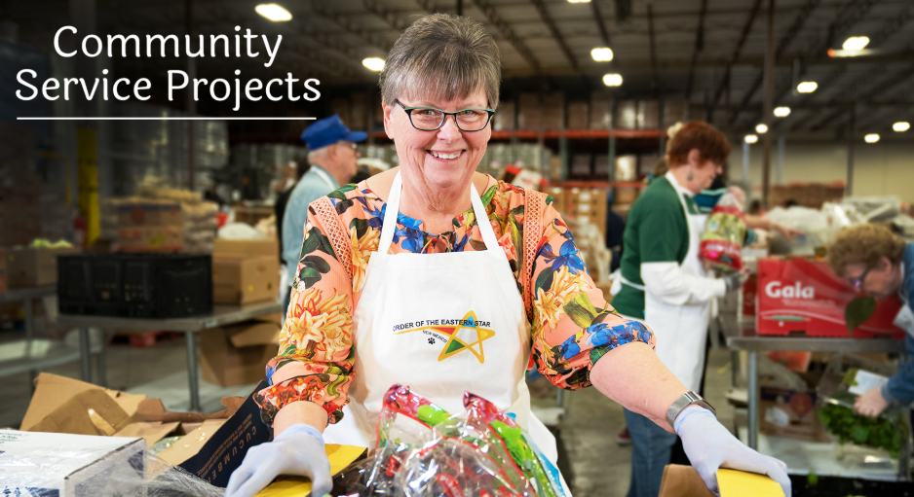
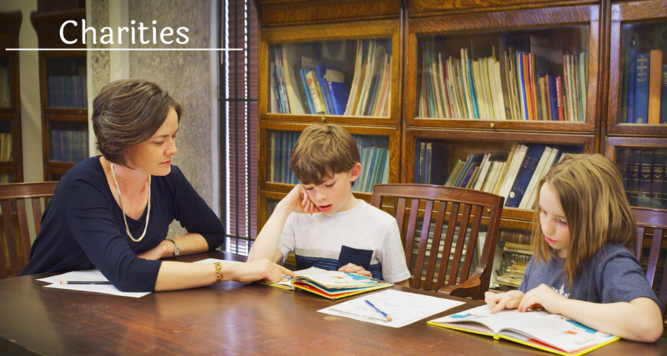
Tested Imagery
Since a photo is worth a thousand words, making sure the most appealing images are used in the digital footprint, various images were tested as far as their appeal, conveyed meaning, and overall interest.
It is very important to convey authentic and appealing images to those who do not know or understand who we are and not to create “barriers” that turn people away from learning more about us.
Score:
Appealing / Interesting = 95
Neutral = 15
Not Appealing / Interesting = 9
Score:
Appealing / Interesting = 82
Neutral = 20
Not Appealing / Interesting = 27
These are weighted scores determined through several dimensions of measurement.

Slide 39
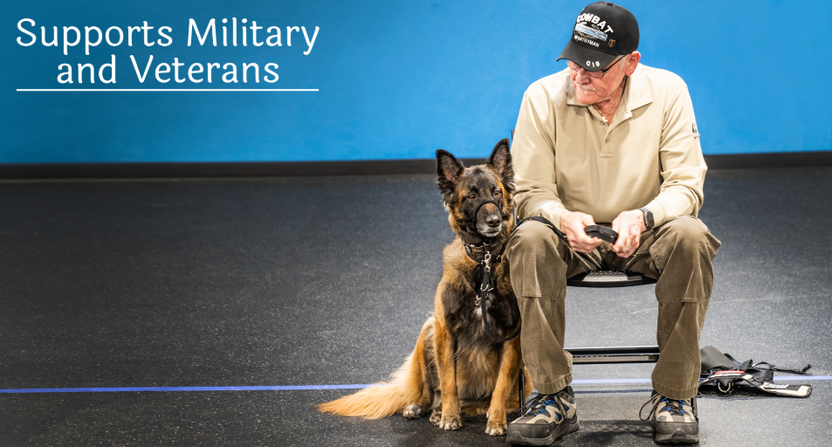
Tested Imagery
Imagery depicting various service / charitable causes
Score:
Appealing / Interesting = 133
Neutral = 15
Not Appealing / Interesting = 9
Score:
Appealing / Interesting = 86
Neutral = 28
Not Appealing / Interesting = 16
These are weighted scores determined through several dimensions of measurement.

Slide 40
Tested Imagery
Working on finding imagery showing our Chapter room experience and setting. Still working on finding imagery that has high appeal values and not “turn people off” because they don’t understand the imagery.
Remember the website imagery, messaging, and purpose is to recruit members, create interest, and not road blocks.
Score:
Appealing / Interesting = 75
Neutral = 23
Not Appealing / Interesting = 27
Score:
Appealing / Interesting = 63
Neutral = 19
Not Appealing / Interesting = 39
These are weighted scores determined through several dimensions of measurement.

Slide 41
There is considerable more data collected on these images, but this is a quick snapshot.
All of the research is then applied to development of marketing strategies.
Additional A/B testing of these images and others to a wider audiences and specific target demos is planned.
Cross-Sectional Data analysis is important in effective targeting campaigns.
Summary Imagery Results
These are weighted scores determined through several dimensions of measurement.
Extremely important to note is the analysis from the comments provided by respondents to each image and the responses especially associated with the last two images. The last two images convey confusion, uncertainty about the organization, barriers to interest, satanic, secret society, etc. The same comments as seen in research on the emblem.

Slide 42
Objective 3
Continued Education / Training for Membership / Enriched Member Experiences
Goals for Objective 3
Work with Membership on their concerns and provide trainings, resources, and support to address those concerns and needs. Membership survey.
Training at Grand Chapter
Committee Training Team
Initiative for members involvement and aid

Slide 43
Objective 3
What New Mexico has been doing –
Internal Organizational Research:
See Results in Next Section. We have to work on the “product” part of the marketing mix as much as we do the “promotion” part of the marketing mix.
Statewide contest for encouragement of member participation and recruitment of new members

Slide 44
Member Survey
A comprehensive study was completed to research several dimensions of membership participation, needs, issues perceived, and more. (Results were received from active and non-active members across the state of NM. A cross demographic of age & length of membership was of core importance to this study.)
An extensive report on the findings in summarized here regarding 16 questions/topics asked of members.
It was often the “other comments” section of these questions that provide the greatest insight into critical internal issues facing our organization.

Slide 45
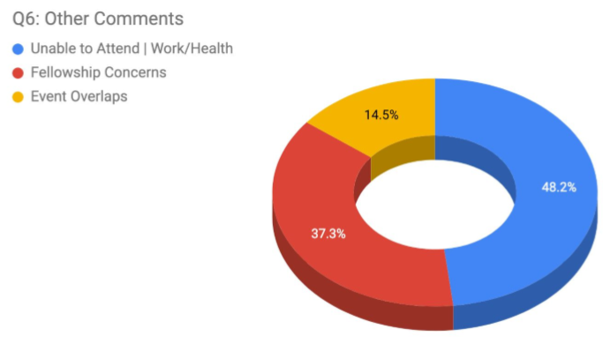
Key Research Findings
Question: Share the reasoning for your responses regarding your lack of attendance to OES functions over the past five years, if you have been a member that long. Through a thematic analysis of the open-ended question, the following three themes emerged.

Slide 46
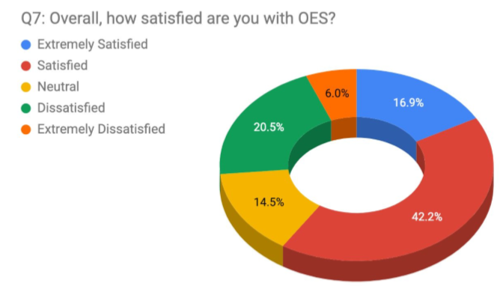
Results Concerning Satisfaction with Belonging

Slide 47
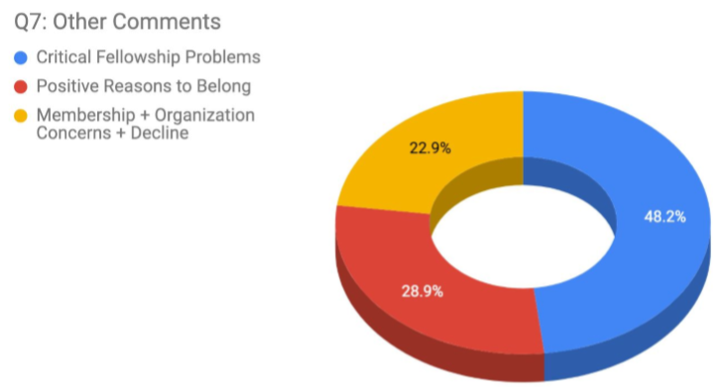
Results When Evaluating Comments from Previous Question
Through a thematic analysis of the comments, the following three themes emerged.

Slide 48
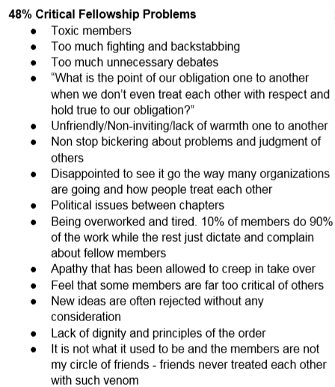
What Were the Predominate Fellowship Problems Noted
The ranking of the following points is based on the number of responses that could be placed under that topic and the overall general comments being made about this serious problem

Slide 49
Reasons to Belong
This summary ranked list helped to develop slogans and various messages to be used in marketing campaigns.

Slide 50
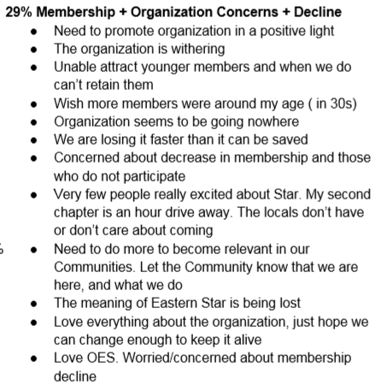
Member Concerns
There are hundreds of comments reviewed, but these seem to common core element of comments.

Slide 51
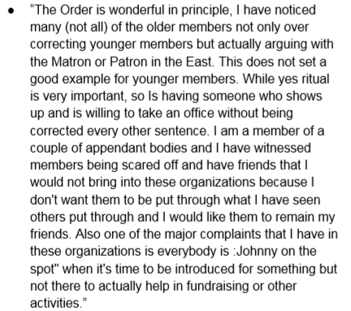
An All-To-Common Comment Seen
This is one members words…

Slide 52
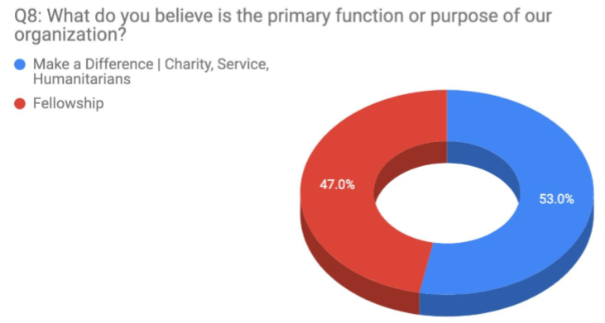
Question: Why We Belong
This response also helped to form marketing messaging. The brand message has to be authentic, so this research helps to “Frame” the message to represent the organization correctly to the outside world.
There is much more researched dimensions to the study, but this was a quick overview.

Slide 53
Objective 4
State-level promotional strategy
(advertising and public relations initiative)
Goals for Objective 4
Once Objective 2 is achieved that included establishing developing a stronger digital footprint, then move into marketing plan stage for promotions. Most likely happening in year 2 and 3.
Placement Google Ads/Management
Placement Social Media advertisements
PR work with state level news releases
Aggressive management of social media
--news distribution / native / organic

Slide 54
Summary
Recap-
Established Objectives
Development of branded materials / membership recruitment tools
Stronger digital footprint (State level and assistance in helping Chapters obtain this)
Continued education / training for membership / Membership enrichment
State-level promotional strategy (advertising and public relations initiative)

Slide 55
If the Truth is not promoted, it is forgotten
There are a lot of people out there who want to make their world a better place through service, why not through OES.
We believe in the values and core principles of our Order—Let’s Lead.

Slide 56
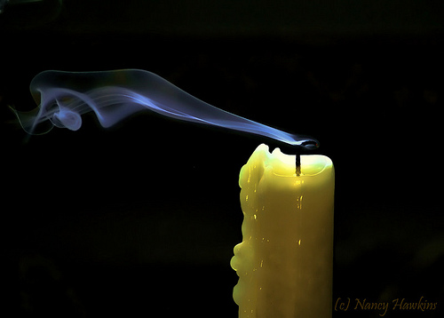
If we don’t, we won’t be
Share the Story
Share the beauty of our organization.
You are the leaders of the
ambassadors of our Brand

Slide 57
Reflect
“Together we enhance lives and communities through service and fellowship based on biblical principles.”
The Power of Three Initiative
Share
1- Join! 2- Learn!
3-Take Initiative to Impact Your World!

Slide 58
It’s time to get excited about OES and how marketing is one part of saving our organization!
For more information contact and get help with marketing contact:
Sabrina Pack-Associated Grand Conductress NM
With SkyWest Media
SabrinaPack@skywestmedia.com
575-956-5428
To get your state’s logo and marketing tools, go to www.oestools.org. A complete brand bible for logo use is available, along with the logo for website development and branding.

